Slide 1

COMPUTERISED LOAN RECORD MANAGEMENT SYSTEM
PREPARED BY: GROUP
SUPERVISED BY: MR. IMAN ABDULRAHMAN

Slide 2
Table of Content
1
Background of the Study
2
Statement of the Problem
3
Aims and Objective of the Study
5
Summary of Literature Review
6
Research Methodology
4
Significance of the Study
7
System Modeling
8
Proposed Interface Design
9
Summary / Conclusion
Presentation Title

Slide 3

Background of Study
Finance is one of the most important aspects of our daily lives. It has gotten to the point that individuals in our society cannot survive without financial loans. Chaudhari et al. (2021).
With the advancement of modern technology, an information system is now regarded as a critical resource in any organization, delivering timely, accurate, and efficient information to ensure enhanced quality service delivery. Integrating information technology solutions offers cooperative management with decision support tools, improves customer connections, and improves organizational efficiency and cooperative member satisfaction. (Santos, 2019)
Loans are a common financial product offered by financial institutions. They involve borrowing money from the institution and agreeing to pay it back, with interest, over a specified period of time. Financial institutions may offer various types of loans, such as personal loans, mortgages, car loans, and business loans, with different terms and interest rates. Wang et al. (2019).
Borrowers typically need to meet certain eligibility criteria and provide collateral or other security in order to qualify for a loan from a financial institution. Loan records are information and documentation related to loans that are provided by a lender to a borrower. These records may include the terms of the loan, such as the interest rate, repayment schedule, and any fees or charges. They may also include the borrower's personal and financial information, as well as details about the loan, such as the loan amount, payment history, and status

Slide 4

Statement of the problem
Despite its usefulness, Manual loan management systems, in which loan records are managed and tracked using paper-based records or spreadsheet software, can suffer from a number of problems and limitations. These can include difficulty in organizing and storing large volumes of loan records, difficulty in accessing and retrieving specific records, and the risk of data loss or damage due to fire, flood, or other disasters. Manual loan management systems can also be prone to errors and inaccuracies, as data may be entered incorrectly or may not be updated in a timely manner. Additionally, manual loan management systems can be time-consuming and labor-intensive, requiring significant manual effort to enter, update, and manage loan records. This can lead to inefficiencies and increased costs and may result in poor customer service and satisfaction.

Slide 5


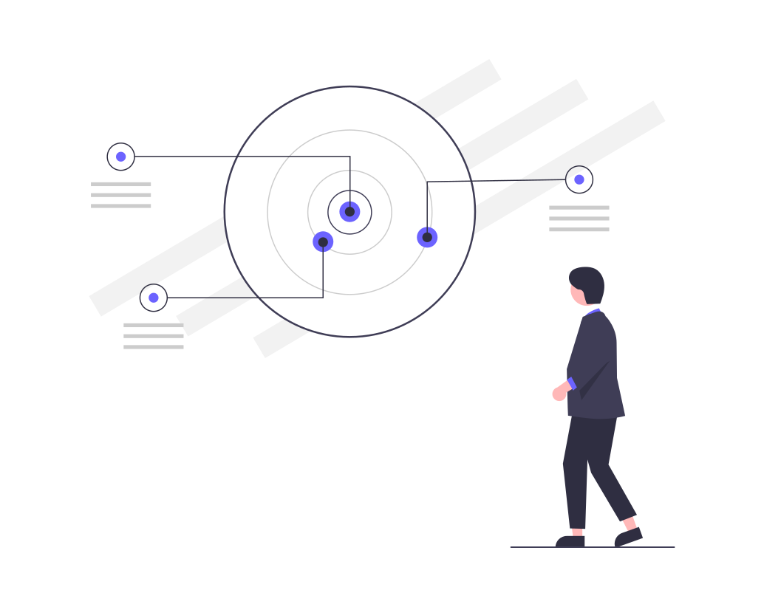
Aim and Objectives of the Study
Aim
To develop a computerized loan record management system
Objectives
In the front-end development modern technologies such as HTML and CSS will be employed to create an interactive User interface as well as Django which is a Python web framework will be employed in developing the back end.
In storing and retrieving the collected dataset; MySQL, an open-source relational database, will be used as the database technology.
Vital testing will be carried out in ensuring the efficacy of the research work

Slide 6

Significance of Study
The development of a computerized loan record management system will streamline the loan process, making it more efficient and accurate. A study on such a system would likely examine the benefits and drawbacks of using such a system, as well as its impact on the loan process and the financial institution that utilizes it

Slide 7
Summary of literature review
Title | Author & Year | Description | Merit | Demerits
Design and Implementation of Loan Management System using ISI Server, PHP, and MySql | Kamruzzaman (2019). | The purpose of this project is to build and construct a loan management system using ISI Server, PHP, and MySql that not only handles the loan portfolios of clients but also streamlines decision-making and loan management operations. | The system provides a platform where clients can apply for a loan from anywhere. | The system is limited only to the web and an internet connection is required
Student Micro Loan Management System. | Chaudhari et al. (2021). | Student Micro Loan Management System is an application that provides users with information about the many forms of loans accessible to students. | This system is a non-profit application that provides students with loans with no interest rate. | The system might lack scalability.

Slide 8
Summary of literature review
Title | Author & Year | Description | Merit | Demerits
Development of a Browser-Based Cooperative Records Management with a Loan Assessment System. | Santos (2021). | CRMSLAS is a browser-based transaction system that enables cooperative members to conduct transactions in a safe and resilient environment. | The CRMLAS has eliminated issues and concerns about loan records and computation. | The system lacks a good user interface.

Slide 9

Research methodology
Choice of programming language
Method of data collection
This study will be a web-based application based on the design of a relational database (SQLite). HTML (hypertext markup language), CSS (cascading style sheet), and JavaScript will be utilized for front-end development, while Django (Python) will be used for back-end programming
Before constructing any system, collecting data and facts about the existing system is necessary to comprehend what is going on. Two approaches were used in this study.
i. Observation of the Work Environment
ii. Documentation

Slide 10
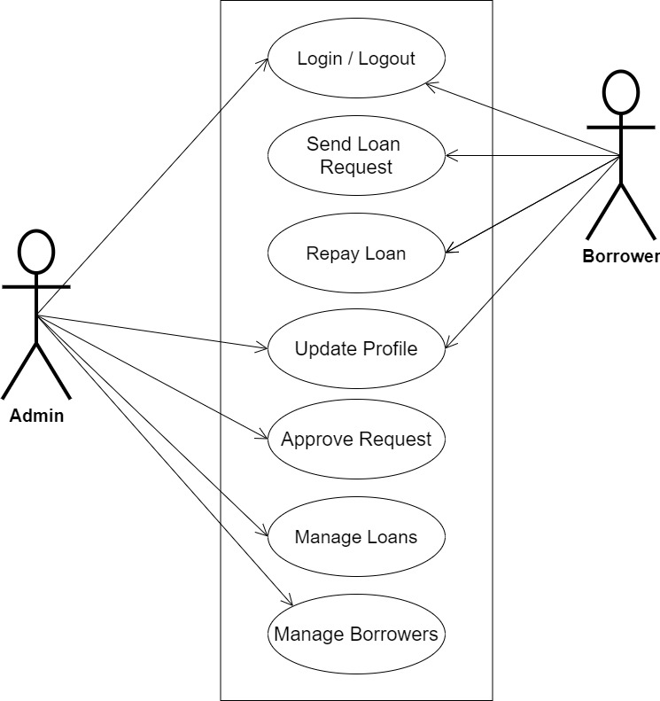
System Modeling (Use Case Diagram)
System Use Case Diagram

Slide 11
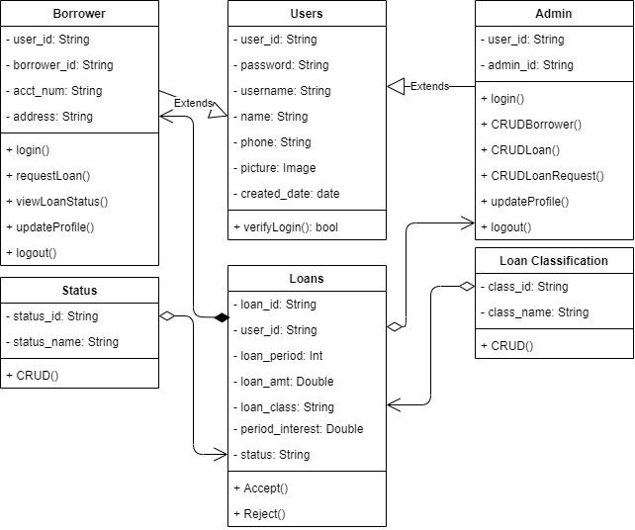
System Modeling (Class Diagram)
System Class Diagram

Slide 12
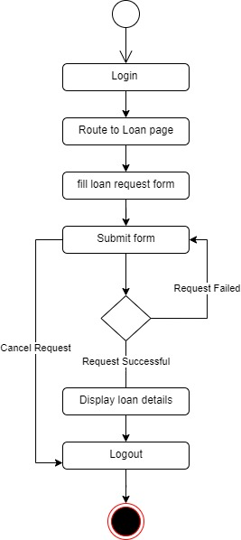
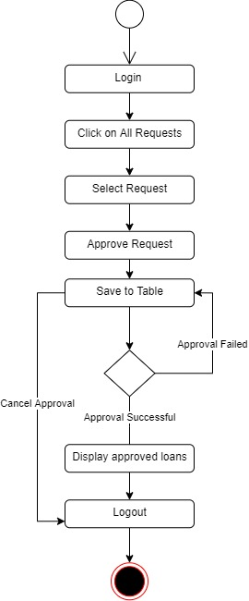
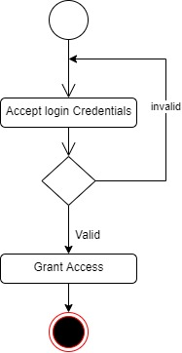
System Modeling (Activity Diagram)
System Login
Request Loan
Approve Loan

Slide 13
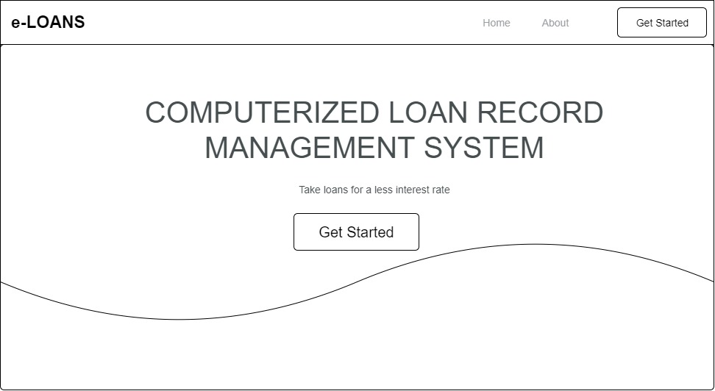
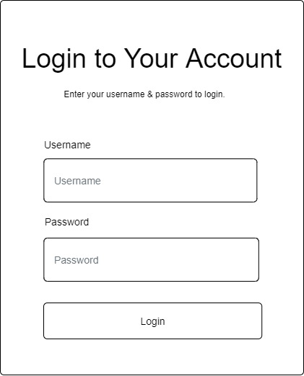
Proposed Interface Design
Homepage
Login page

Slide 14

Summary
The development of a computerized loan record management system will streamline the loan process, making it more efficient and accurate. A study on such a system would likely examine the benefits and drawbacks of using such a system, as well as its impact on the loan process and the financial institution that utilizes it.

Slide 15

Thank you

